Slide 1
Power Supply Unit
Higher National Diploma in Information Technology

Slide 2
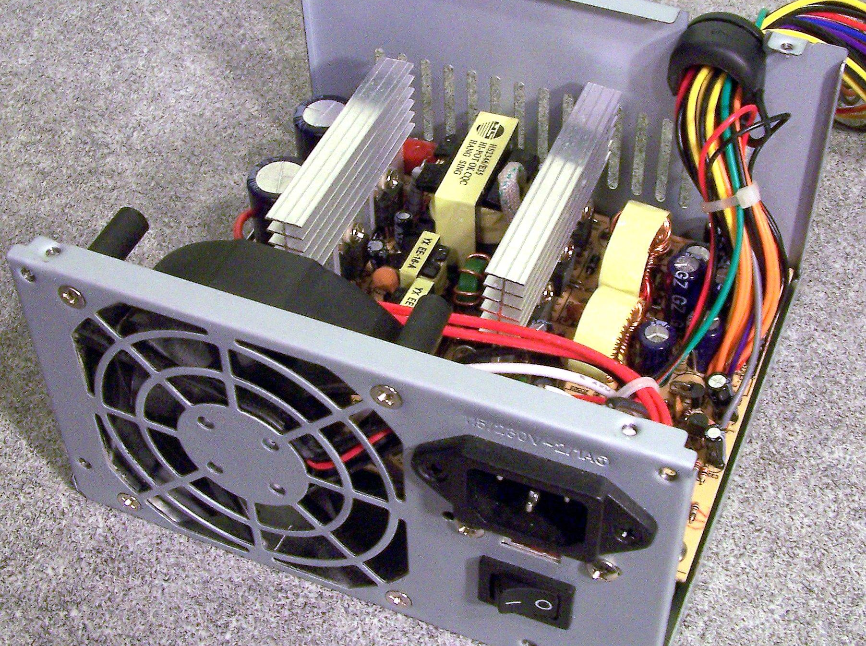
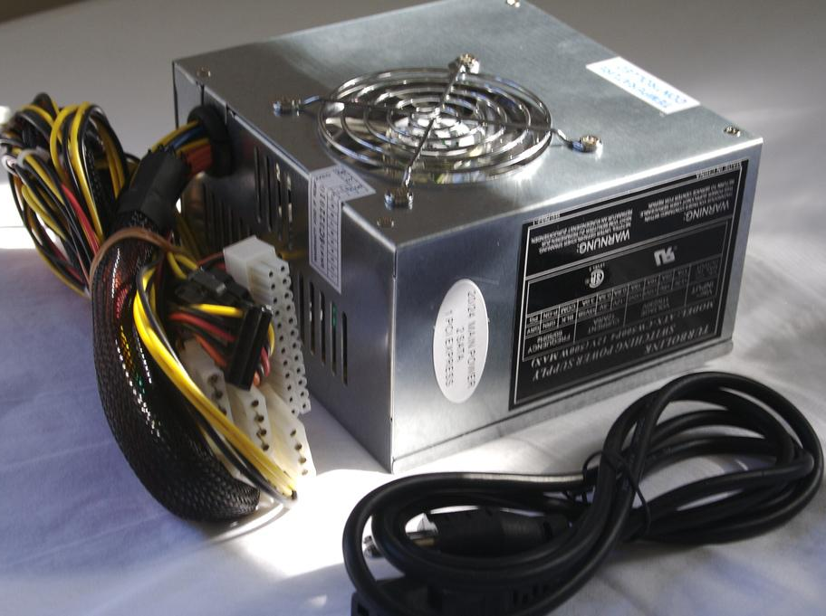
Power Supply Unit
Provide power to every devices such as Hard Disk, DVD Rom / DVD Writers, Floppy Disk, Motherboard.
Typically there are 300W and 400W power supplies available
Every power supply provides 5V and 12V outputs

Slide 3
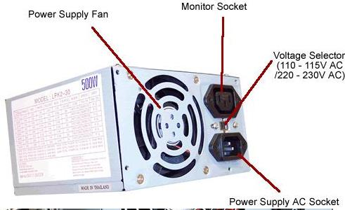
A power supply unit (PSU) converts mains AC to low-voltage regulated DC power for the internal components of a computer

Slide 4
Power Supply Connectors
Use to connect the power supply with mother board and other components

Slide 5
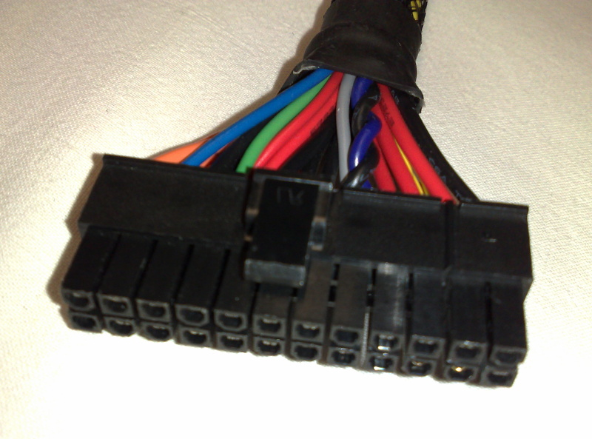
ATX style connector
• Power supply to mother board
• 20 pin or 24 pin

Slide 6
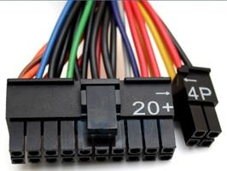
ATX-2
• The extra 4 pins
• To power a PCI-E graphics card.

Slide 7
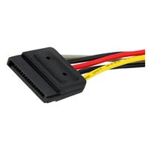
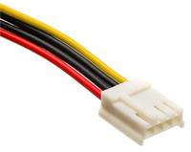
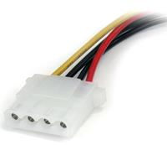
SATA Power Connector
4-pin Floppy Power Connector
Hard drive / CD/DVD power connectors

